Slide 1

UNIVERSITY COLLEGE OF SCIENCE AND TECHNOLOGY
INSTITUTE OF RADIO PHYSICS AND ELECTRONICS
REPORT ON MINI-PROJECT
TOPIC: DESIGN OF CLIPPERS AND CLAMPERS CIRCUIT USING DIODE
SOHELA BANERJEE CU Reg No:031-1211-0277-19 CU Roll No: T91/ECE/226011 Class Roll No:305
SWAPNIL SAHA CU Reg No:012-1111-0753-20 CU Roll No: T91/ECE/226013 Class Roll No:313
AAYAN AHMED CU Reg No:D01-1115-0250-22 CU Roll No: T91/ECE/224064 Class Roll No:436
STREAM: ELECTRONICS AND COMMUNICATION ENGINEEERING
SUBJECT: MINI-PROJECT ON ELECTRONIC DESIGN
SUBJECT CODE: EC3.2.10
SESSION:2025

Slide 2
Project Overview & Contents
This project focuses on the design, simulation, and practical implementation of various clipper and clamper circuits using diodes, aimed at understanding their behaviour in signal conditioning applications.
A combination of clipper and clamper circuits is also explored to demonstrate waveform shaping. This circuit is simulated using circuit design tools and then implemented on a custom-designed Printed Circuit Board (PCB) to demonstrate real-time behaviour. The project highlights the practical use of diodes, resistors, capacitors, and voltage sources in shaping and conditioning analog signals, which are essential in communication and electronic systems.
Contents:
Introduction To Clipper And Clamper Circuits With Different Circuit Designs
Design and analysis of clipper-clamper circuits for signal conditioning of sinusoidal signals
Printed circuit board (PCB) design
Result And Discussion

Slide 3
Clipper Circuits: Theory & Types
Clipping circuits are used for removing or cutting off portions of an input signal that go beyond a certain voltage level.
Performed using diodes, resistors, and sometimes biasing voltages.
Used to limit the amplitude of the signal.
Output waveform is flattened above or below a threshold.
It does not shift the signal — only limits certain parts.
NOTE: Choosing the correct resistance value (R) in clipper circuits — whether series or shunt, positive or negative, biased or unbiased — depends on the circuit's desired behavior, diode specifications, and the input signal properties.
FOR SERIES CLIPPER CIRCUIT:
Choose a moderate to high value
To limit the current when the diode conducts.
To ensure voltage drop appears mainly across the diode (during conduction).
Resistance should not be too high, else the signal will be severely attenuated.
FOR SHUNT CLIPPER CIRCUIT:
Choose a relatively low value
To provide a path for current when diode conducts.
To develop enough voltage drop across it for proper clipping.
If Resistance is too large, the diode might not get enough forward voltage to turn ON.

Slide 4
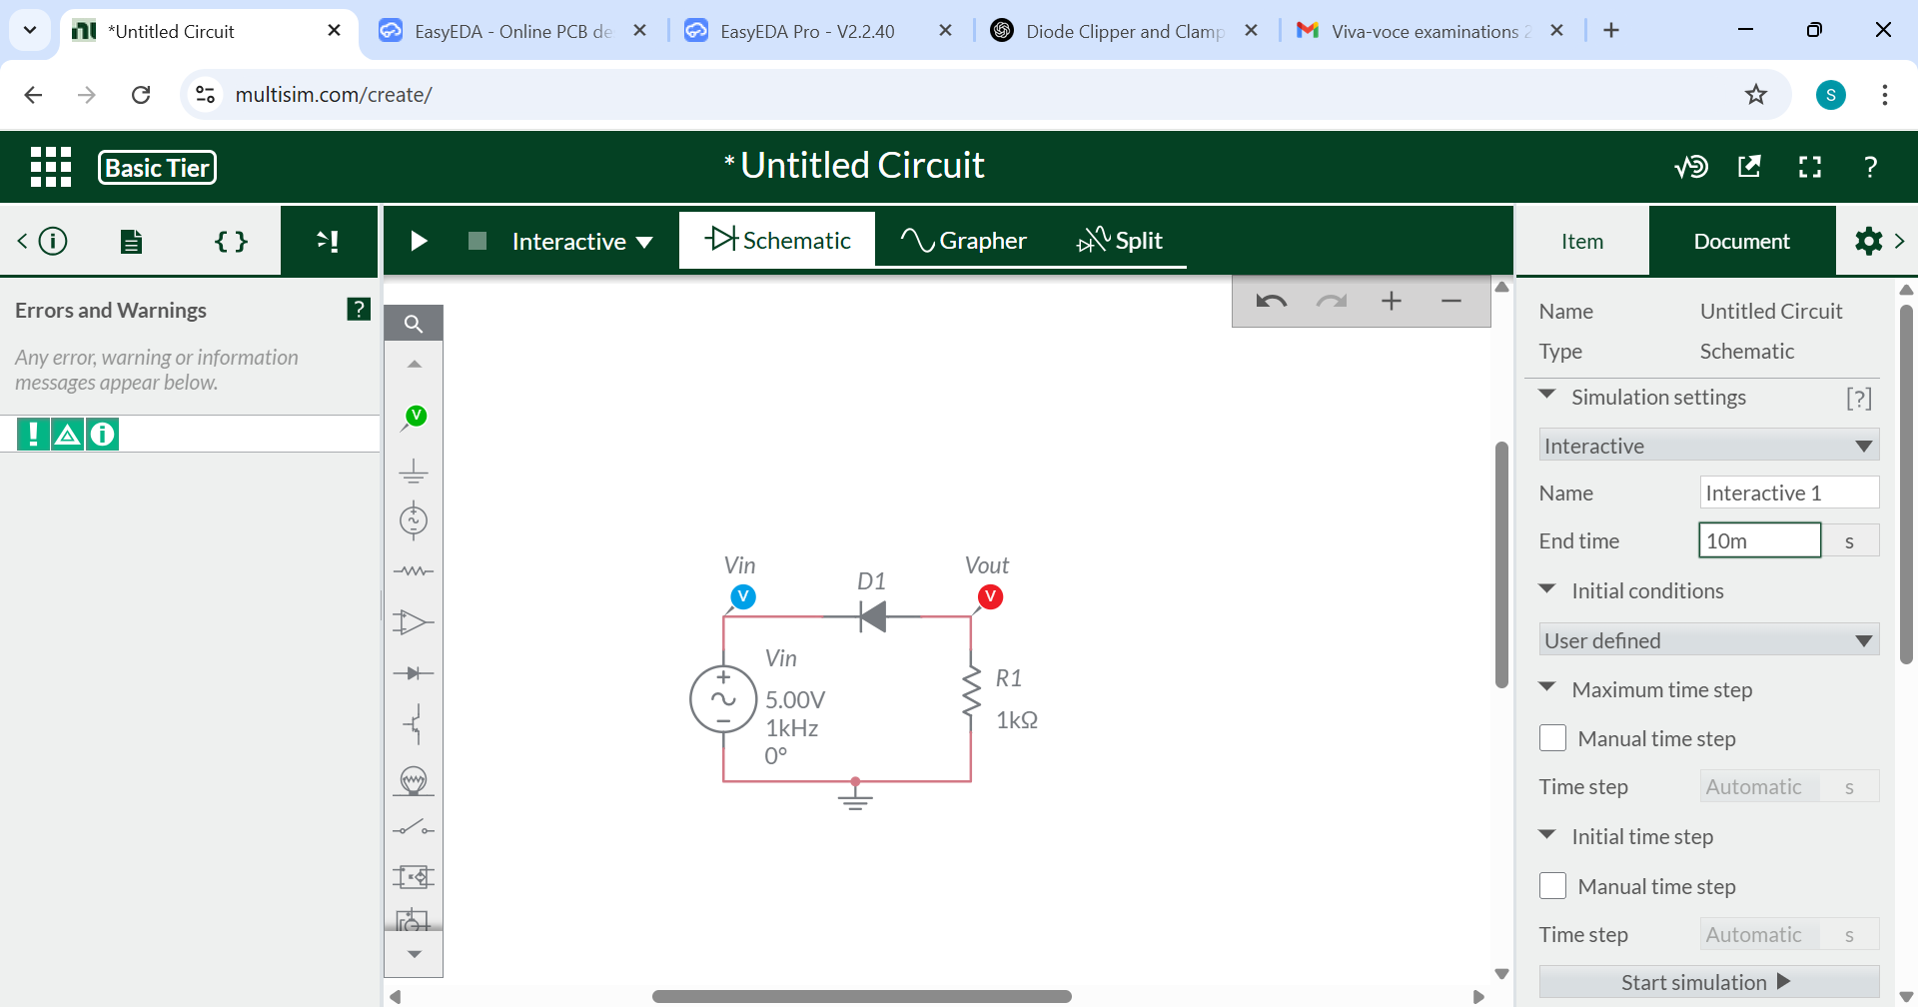
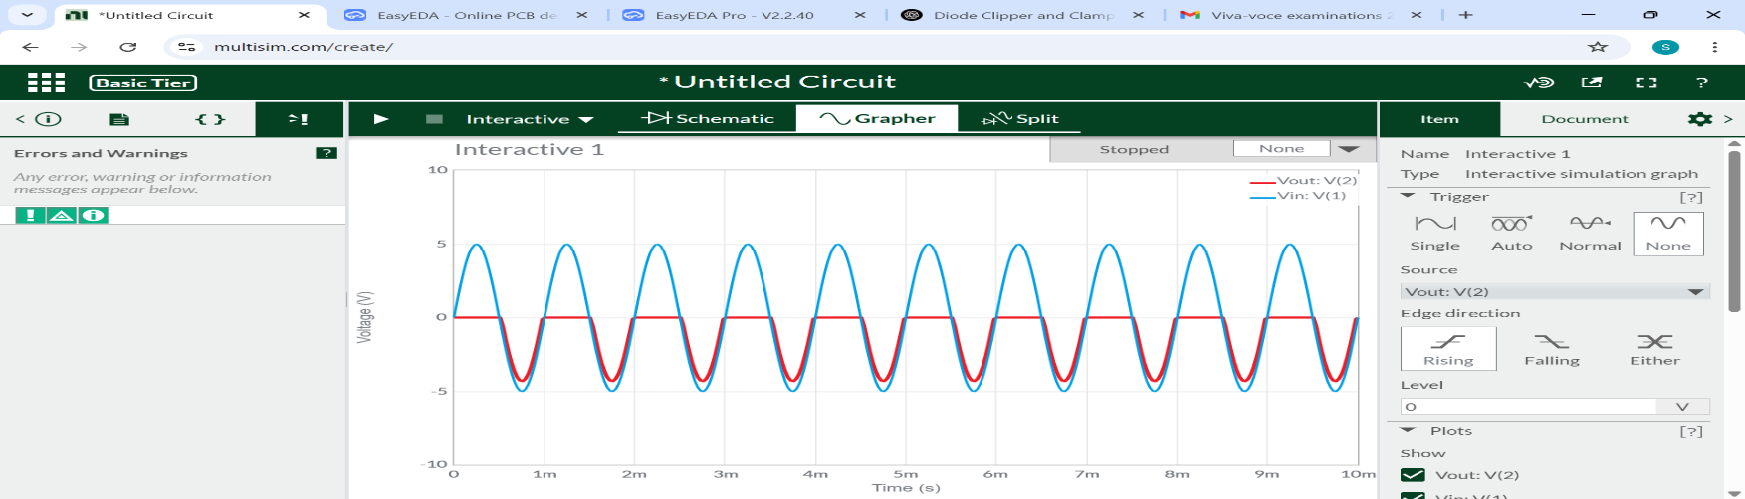
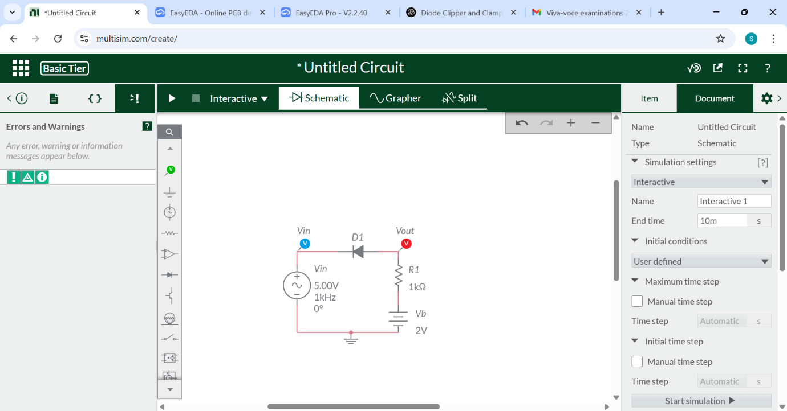
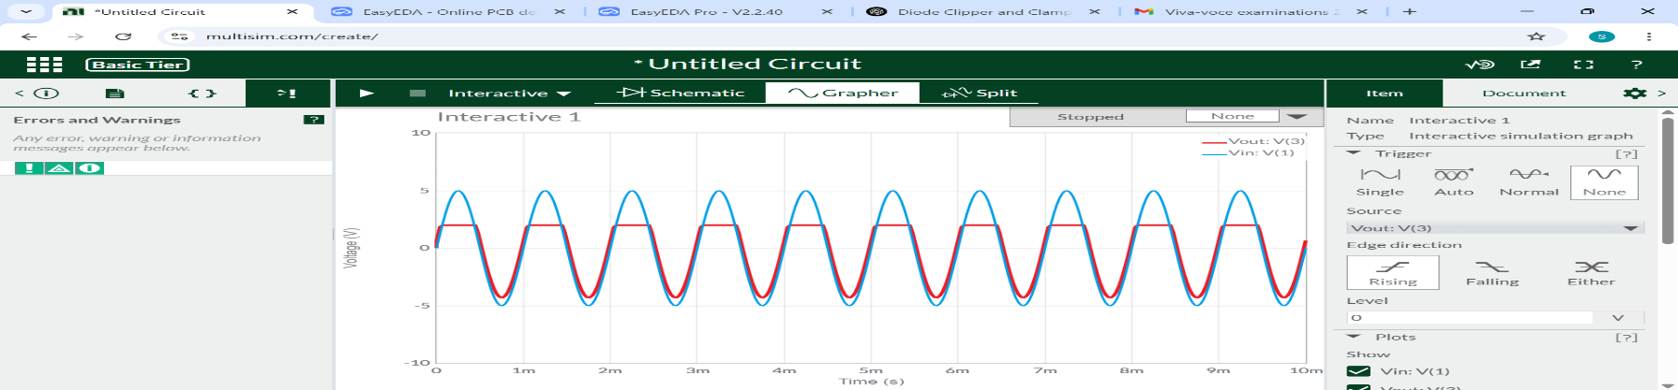

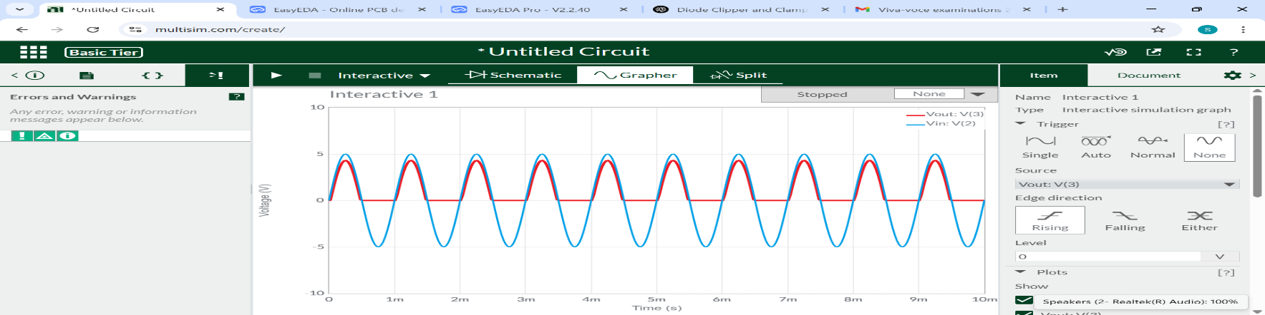
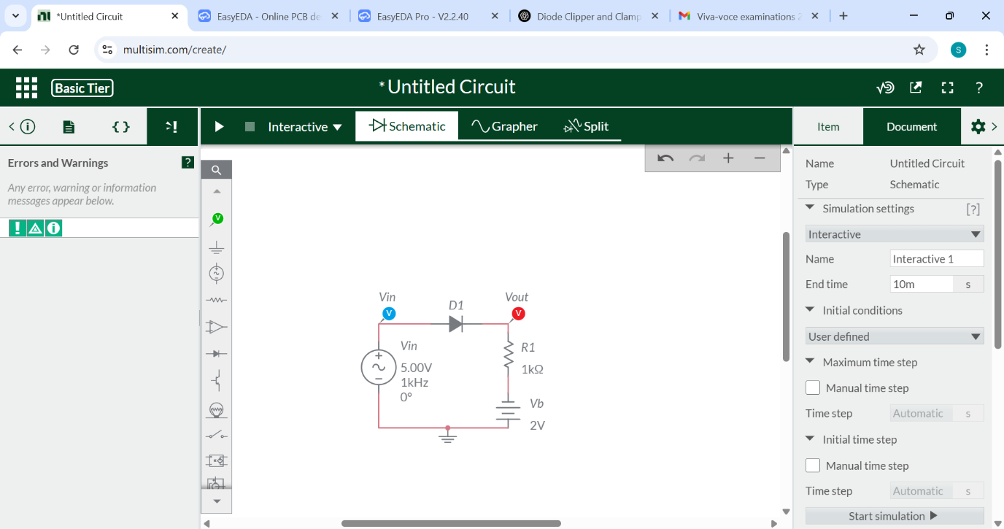
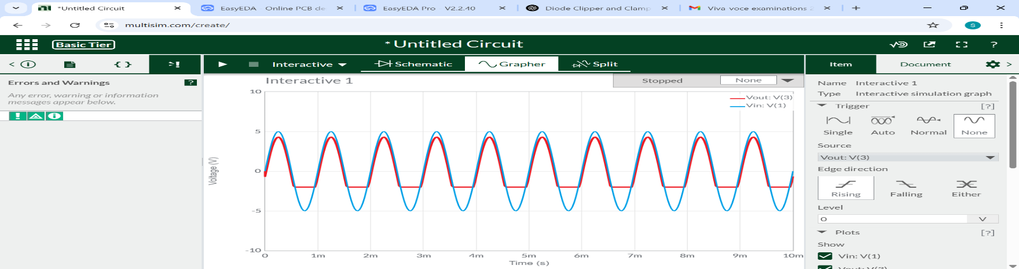
SERIES POSITIVE CLIPPER CIRCUIT
UNBIASED CONDITION
BIASED CONDITION
Fig.1.1: Circuit Diagram
Fig.1.2: Corresponding Input and Output Waveform
Fig.2.1: Circuit Diagram
Fig.2.2: Corresponding Input and Output Waveform
SERIES NEGATIVE CLIPPER CIRCUIT
UNBIASED CONDITION
BIASED CONDITION
Fig.3.1: Circuit Diagram
Fig.3.2: Corresponding Input and Output Waveform
Fig.4.1: Circuit Diagram
Fig.4.2: Corresponding Input and Output Waveform

Slide 5
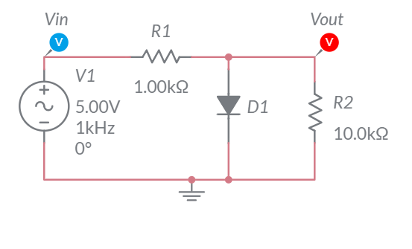
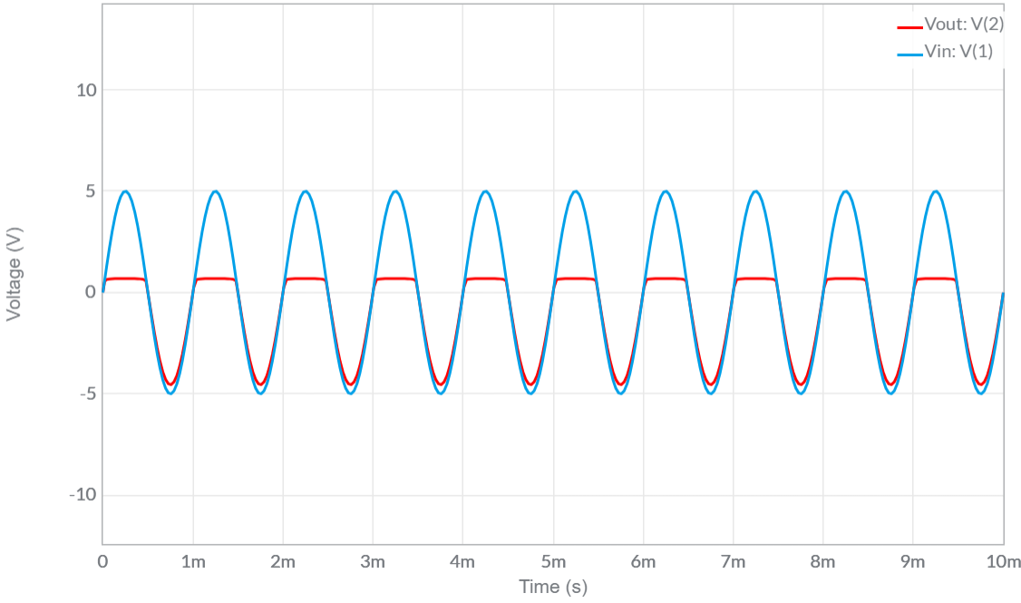
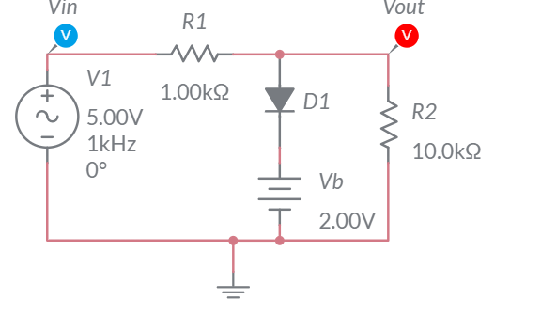
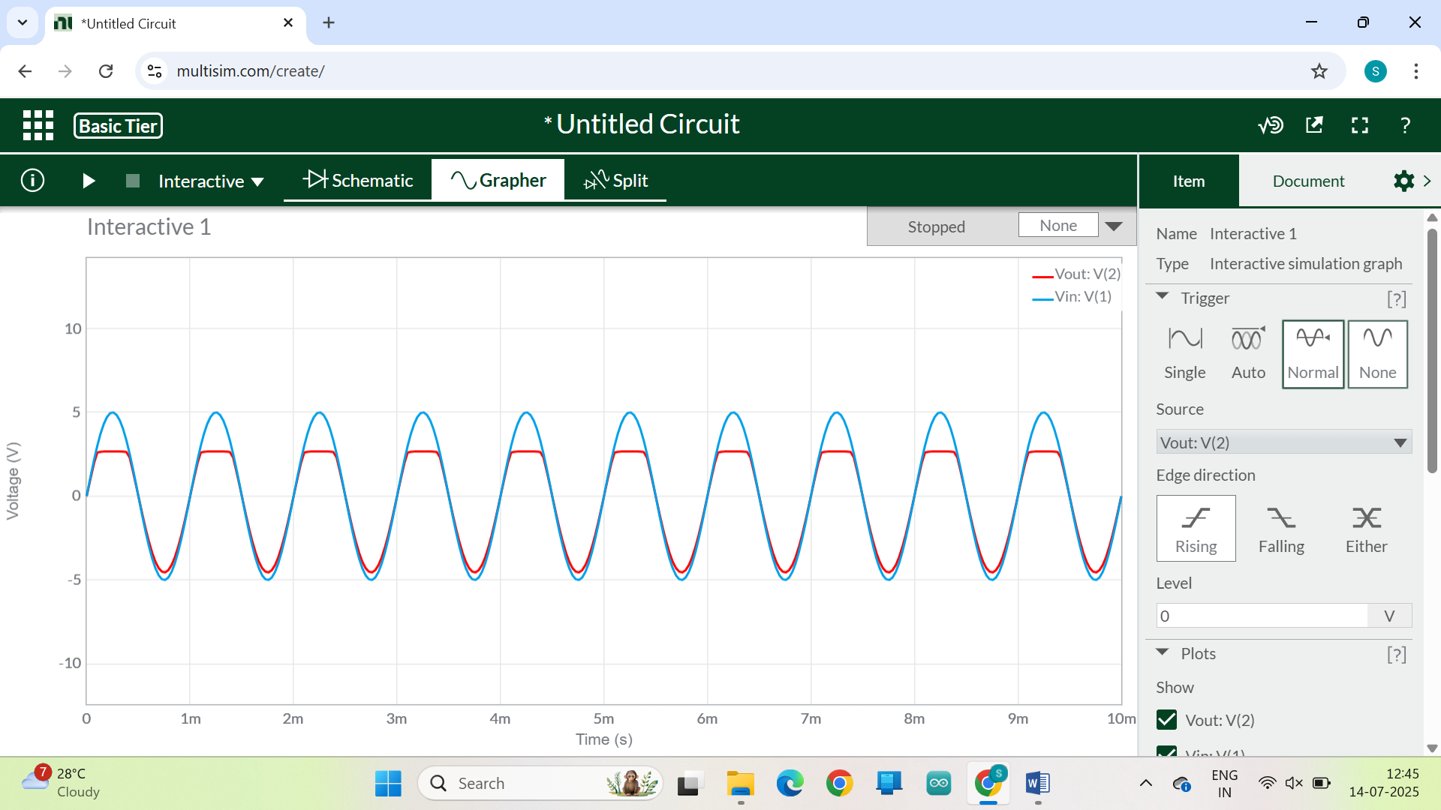
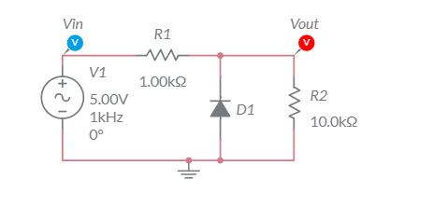
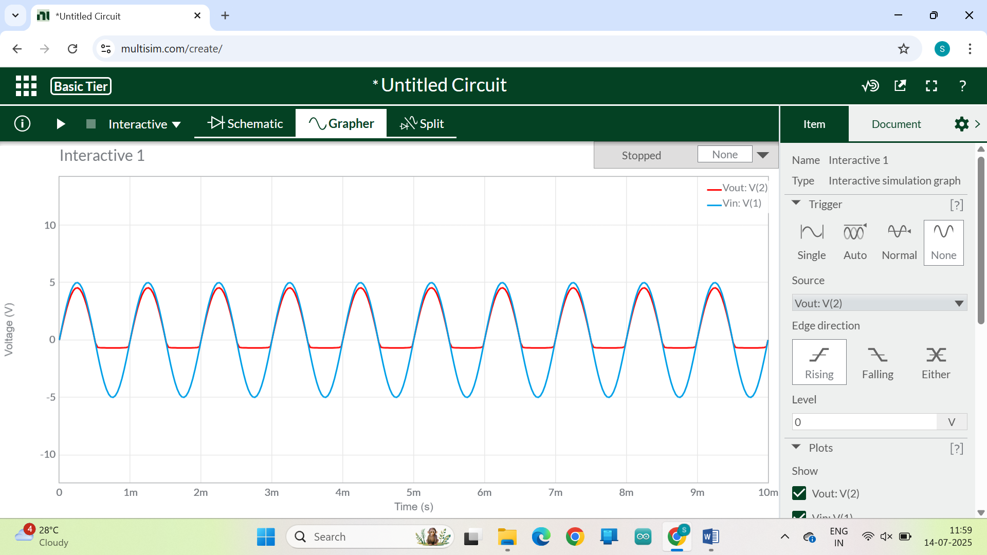
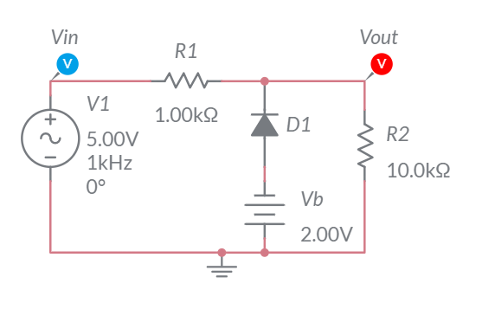
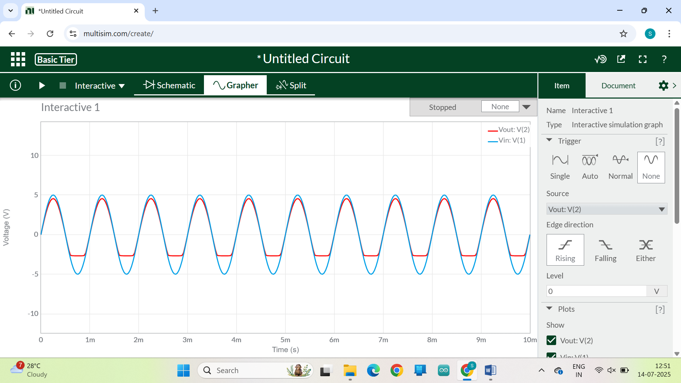
SHUNT POSITIVE CLIPPER CIRCUIT
UNBIASED CONDITION
BIASED CONDITION
Fig.5.1: Circuit Diagram
Fig.5.2: Corresponding Input and Output Waveform
Fig.6.1: Circuit Diagram
Fig.6.2: Corresponding Input and Output Waveform
SHUNT NEGATIVE CLIPPER CIRCUIT
UNBIASED CONDITION
BIASED CONDITION
Fig.7.1: Circuit Diagram
Fig.7.2: Corresponding Input and Output Waveform
Fig.8.1: Circuit Diagram
Fig.8.2: Corresponding Input and Output Waveform

Slide 6
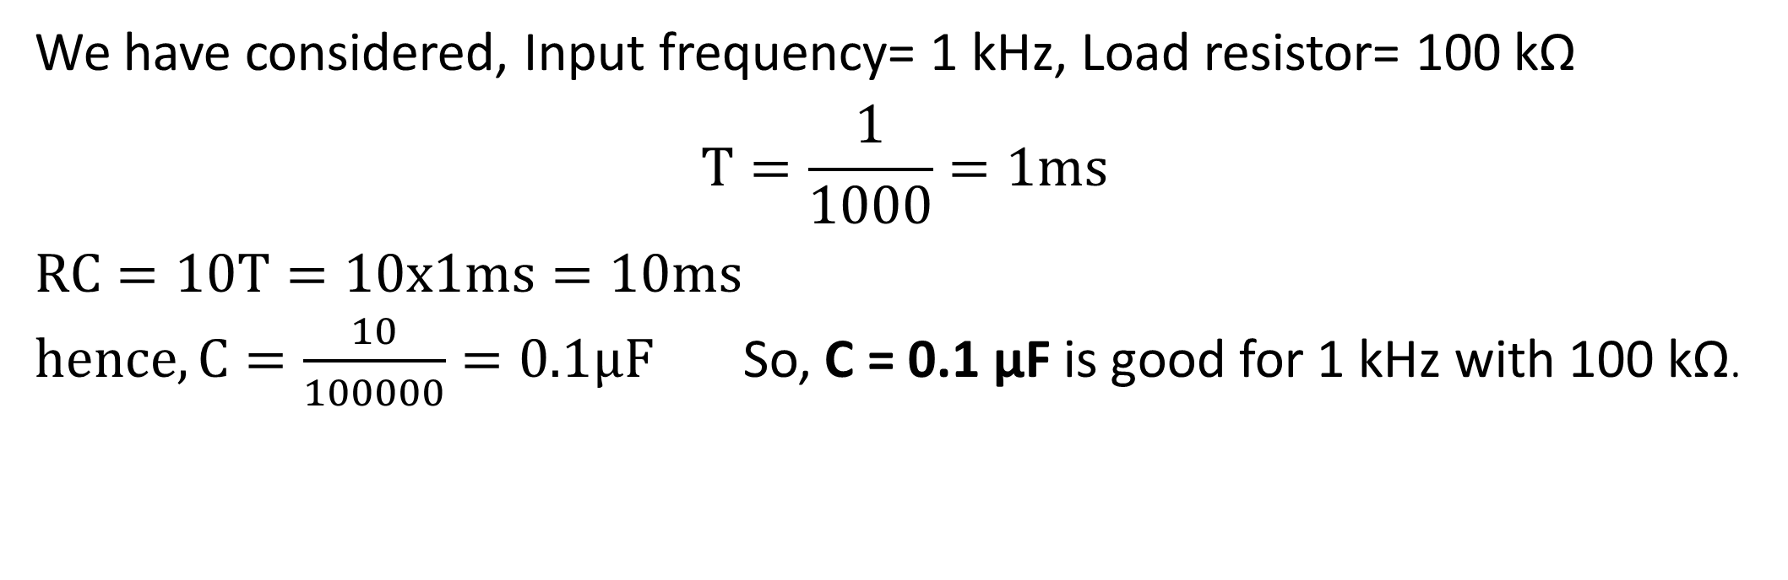
Clamper Circuits: Theory & Types
Clamping circuits are used for shifting the entire signal up or down without changing its shape.
Uses diodes, capacitors, and sometimes biasing voltages.
The peak value remains the same, but the DC level changes.
It adds a DC offset to the signal.
Clamping moves the entire waveform above or below the zero level.
We have considered, Input frequency= 1 kHz, Load resistor= 100 kΩ $$T=\frac{1}{1000}=1ms$$
$RC=10T=10x1ms=10ms$
$hence, C=\frac{10}{100000}=0.1μF$ So, C = 0.1 µF is good for 1 kHz with 100 kΩ.

Slide 7
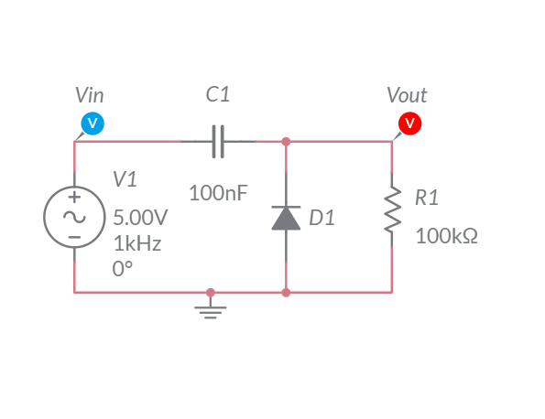
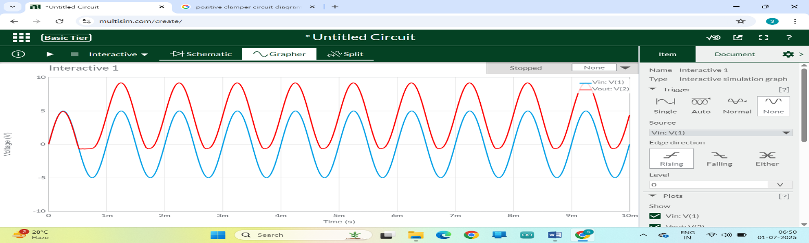
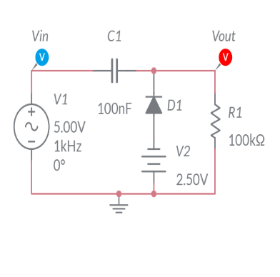
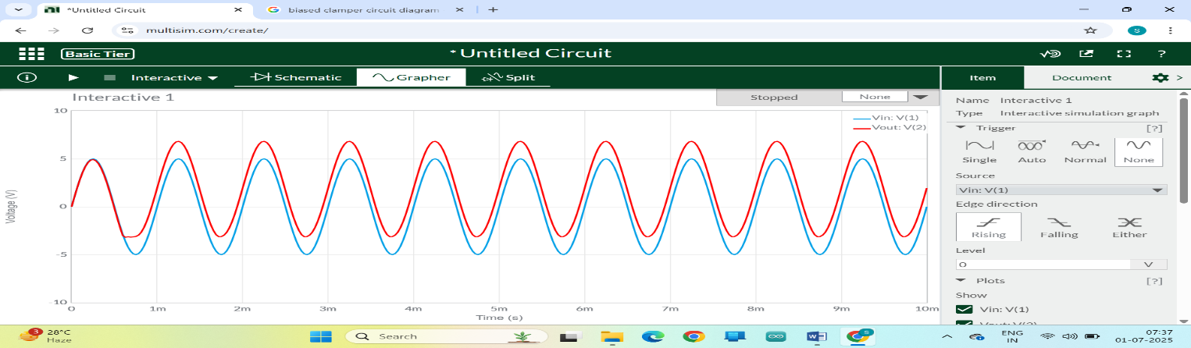
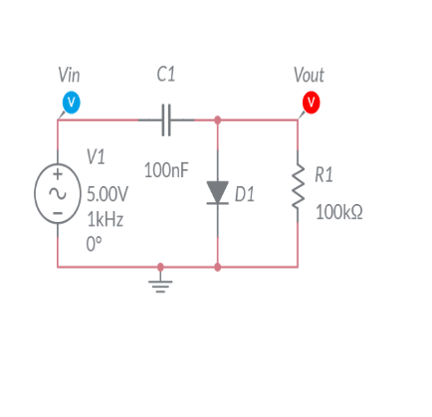
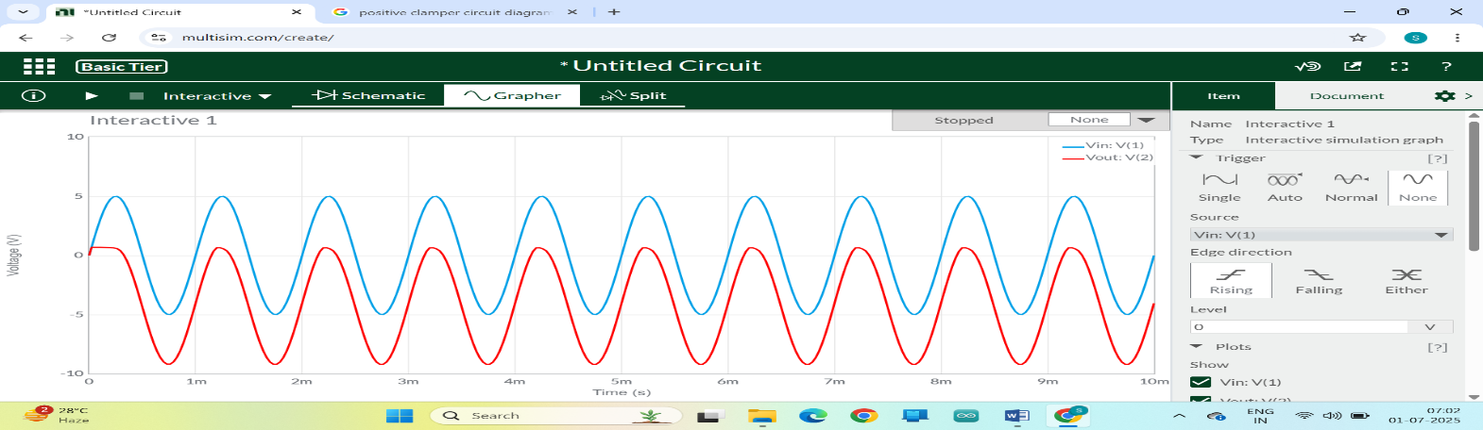
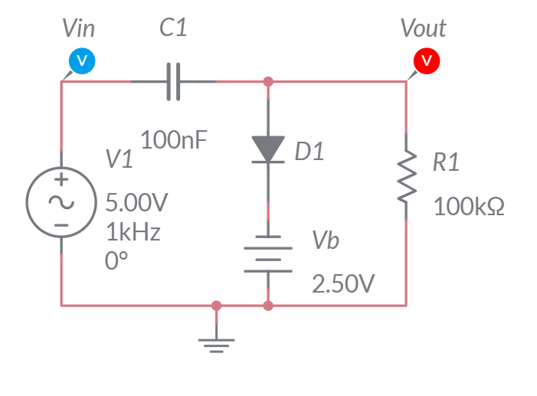
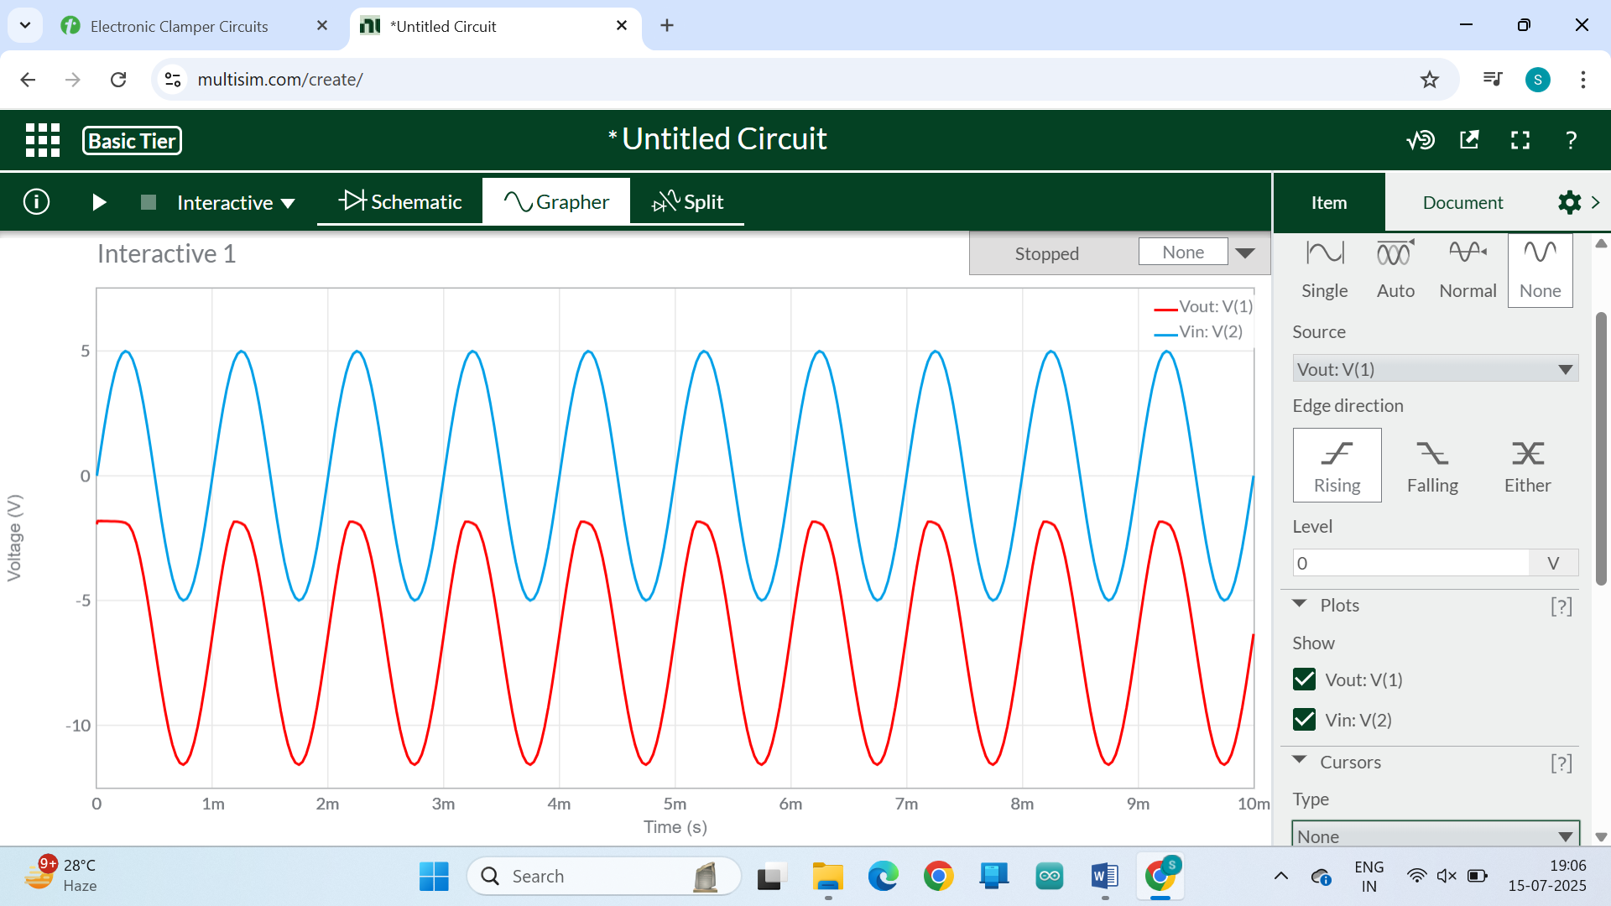
POSITIVE CLAMPER CIRCUIT
UNBIASED CONDITION
BIASED CONDITION
Fig.9.1: Circuit Diagram
Fig.9.2: Corresponding Input and Output Waveform
Fig.10.1: Circuit Diagram
Fig. 10.2: Corresponding Input and Output Waveform
NEGATIVE CLAMPER CIRCUIT
UNBIASED CONDITION
BIASED CONDITION
Fig.11.1: Circuit Diagram
Fig.11.2: Corresponding Input and Output Waveform
Fig.12.1: Circuit Diagram
Fig. 12.2: Corresponding Input and Output Waveform

Slide 8
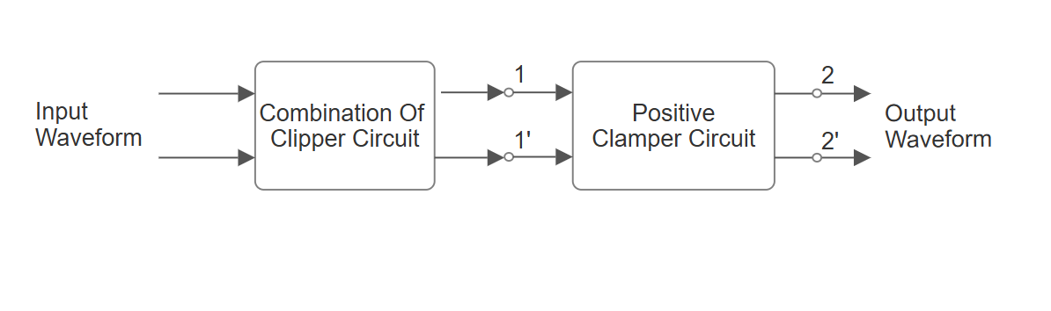
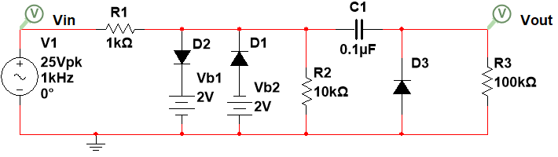
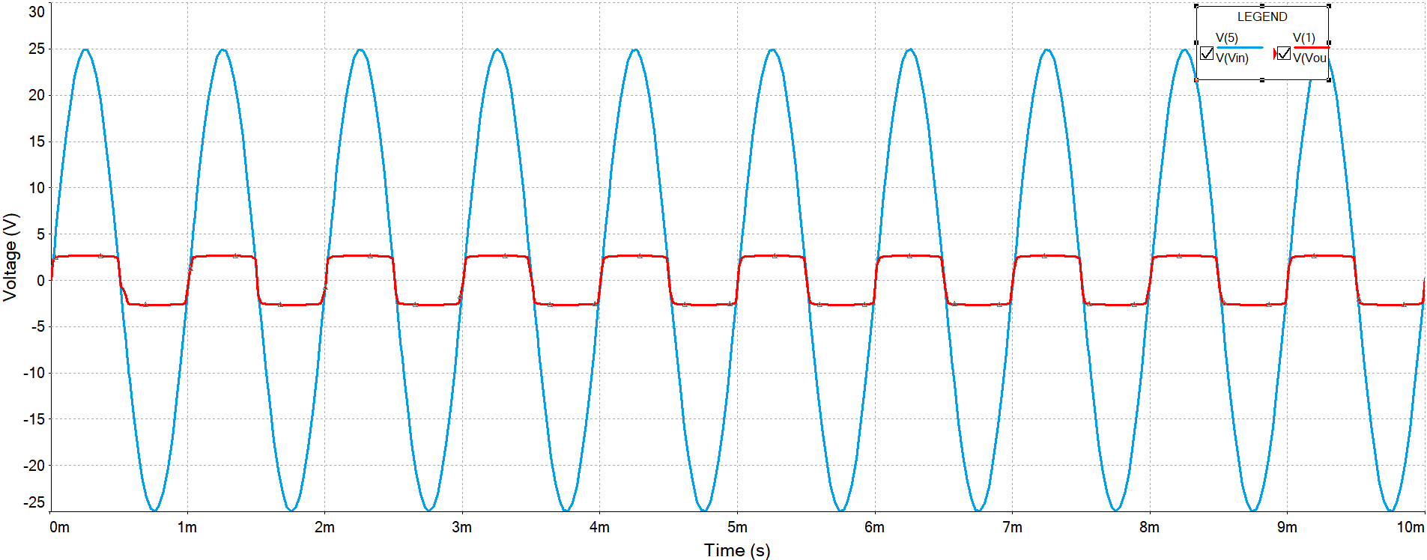
DESIGN AND ANALYSIS OF CLIPPER-CLAMPER CIRCUITS FOR SIGNAL CONDITIONING OF SINUSOIDAL SIGNALS
Fig.13.1: Block Diagram
Fig.13.2: Circuit Diagram
For Combination Of Clipper Circuit: We applied a 25 V peak-to-peak, 1 kHz sinusoidal input with 0° phase. The first block is a combination clipper using two diodes and two bias voltages (±2 V) to clip both positive and negative parts of the signal.
For positive input > +2 V, D2 conducts, output is clipped at +2 V.
For negative input < -2 V, D1 conducts, output is clipped at -2 V. This limits the signal between +2 V and -2 V.
Fig.13.3: Corresponding Input and Output Waveform At 1-1’

Slide 9
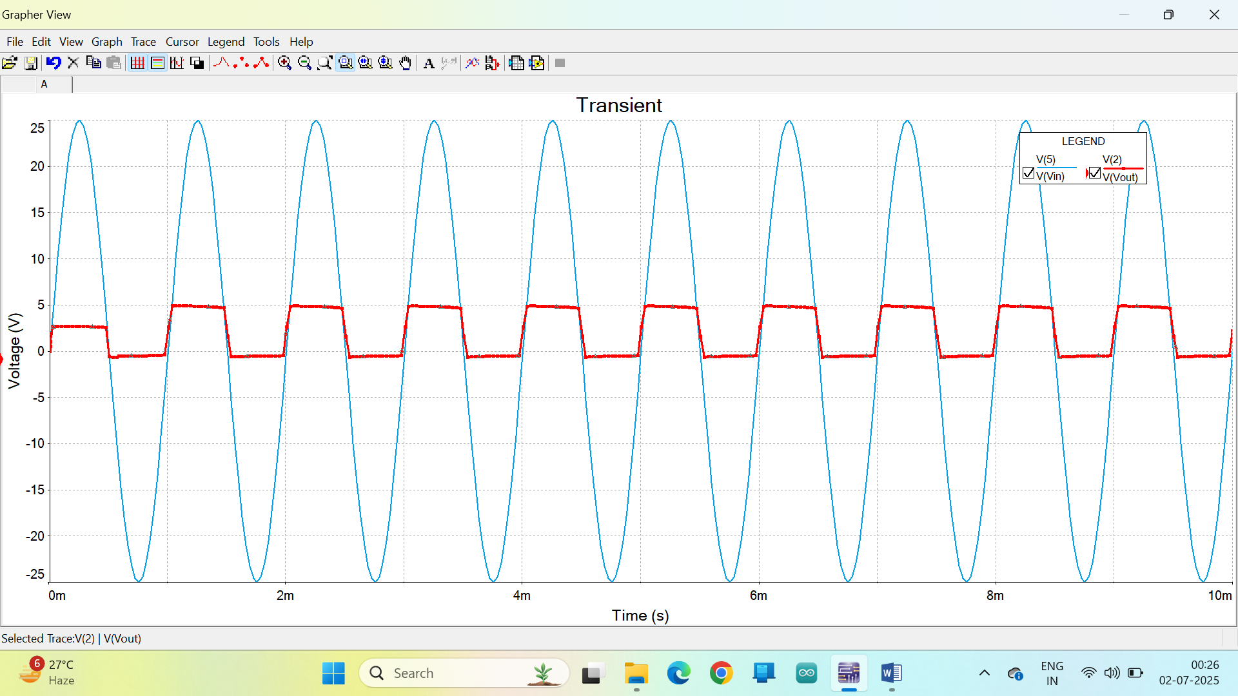
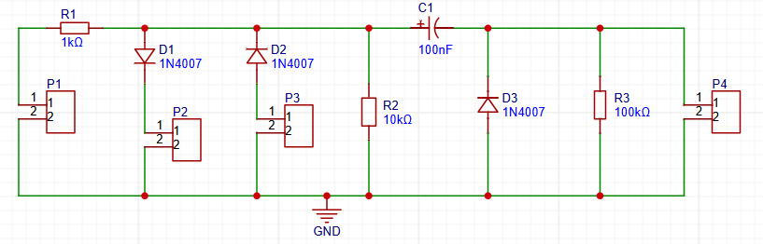
For Positive Clamper Circuit:The output from the clipper circuit is fed into a positive clamper. Initially, the diode is reverse biased. During the negative half cycle, the diode conducts and charges the capacitor to 2V. In the next positive half cycle, the diode is reverse biased, and the output becomes Vout=Vin+2V, thus shifting the signal positively.
Fig.13.4: Corresponding Input and Output Waveform At 2-2’
Components Required:
•SCREW TERMINAL BLOCKS (P1,P2,P3&P4) •FUNCTION GENERATOR •C.R.O(Cathode Ray Oscilloscope) •SINGLE STRANDED WIRE •PCB (Printed Circuit Board)
FOR CLIPPING CIRCUIT •AC VOLTAGE SOURCE •RESITANCE – 1KΩ & 10KΩ •TWO DIODES (D1 & D2) •TWO 2V DC SOURCE (Vb1 &Vb2)
FOR CLAMPER CIRCUIT •CAPACITOR – 0.1μF •RESISTANCE – 100KΩ •DIODE(D3)
Fig.14.1: Circuit Diagram For PCB Design Using EasyEDA

Slide 10
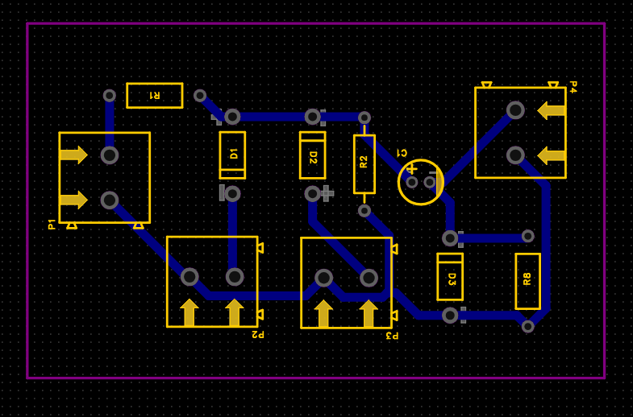
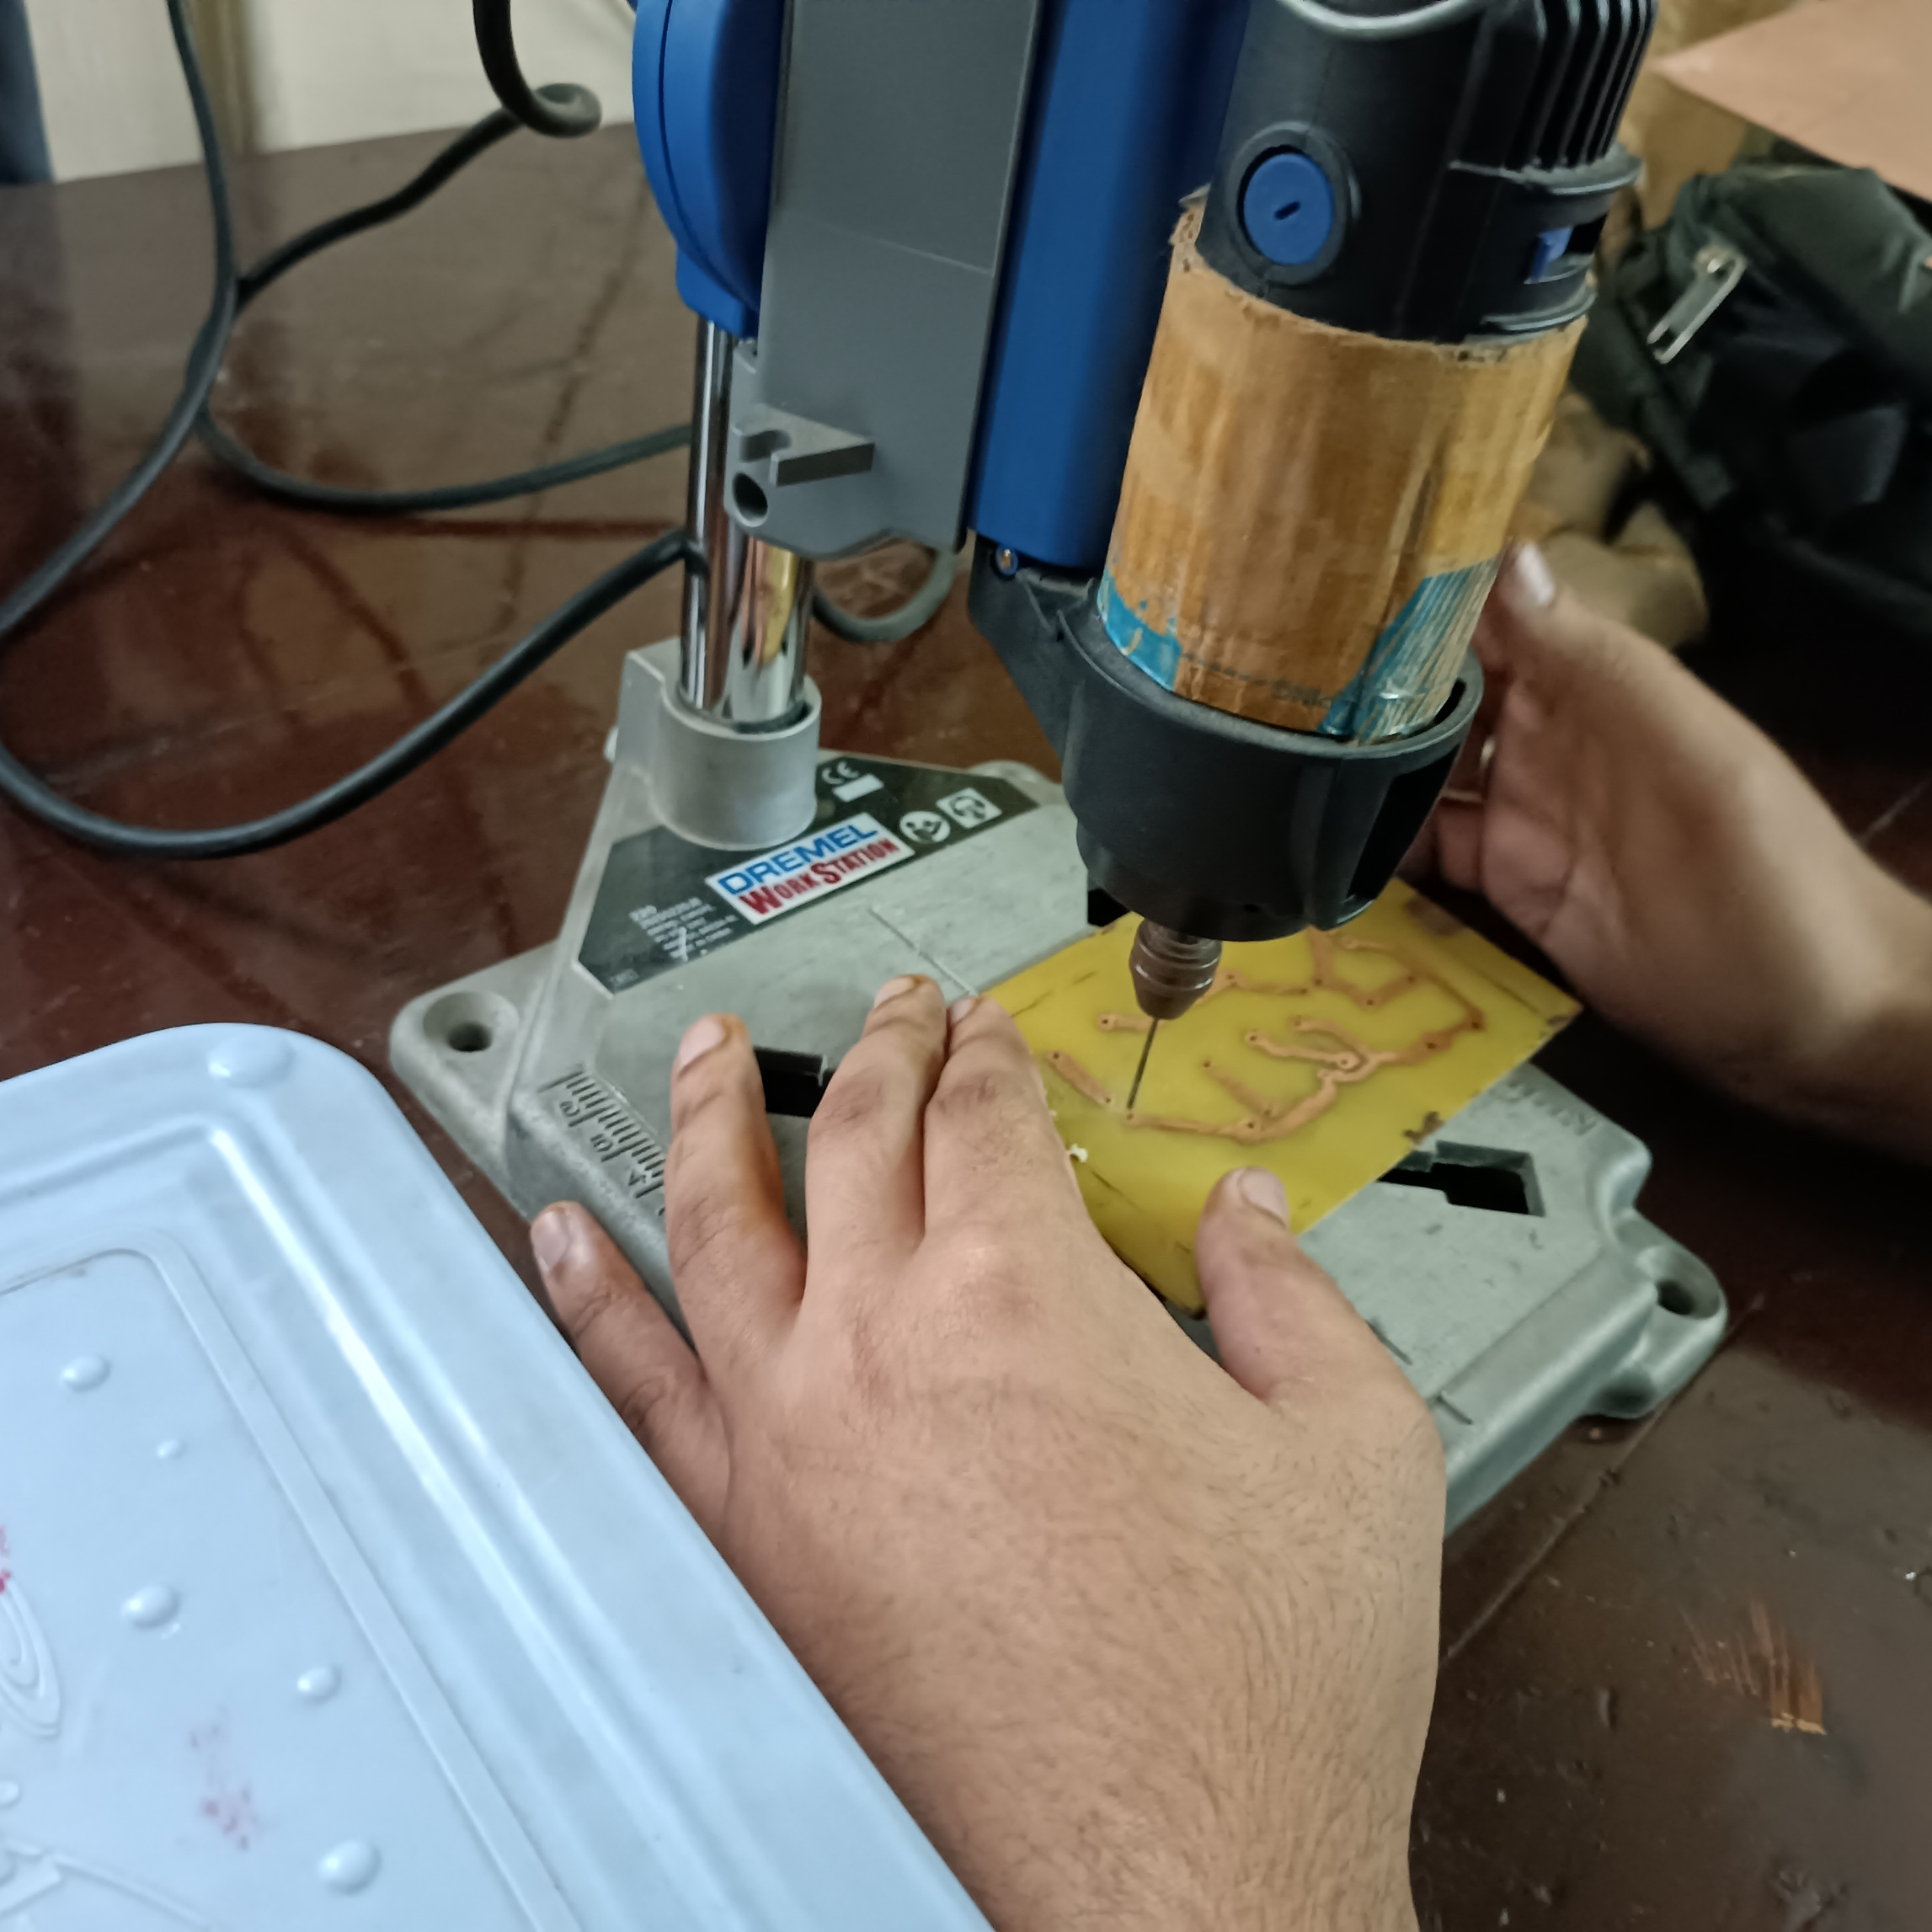
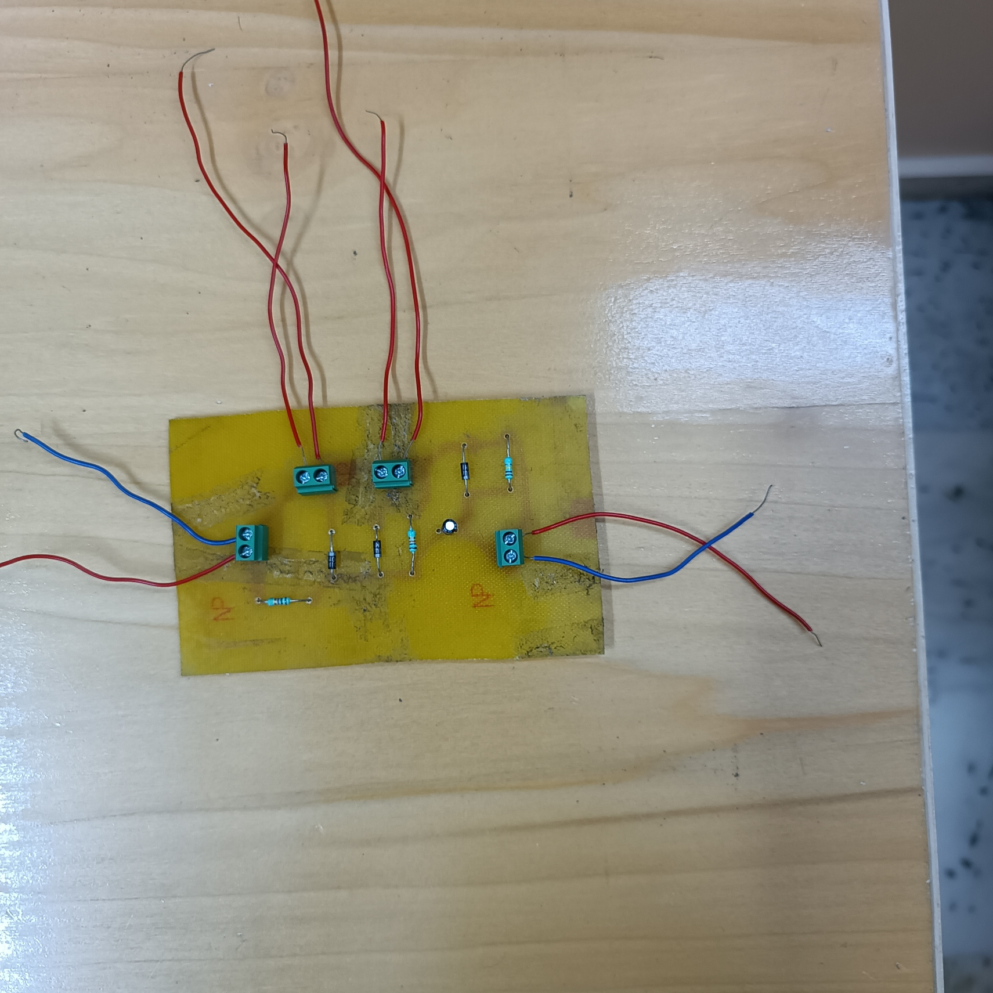
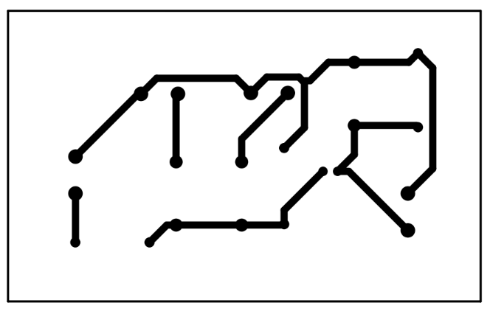
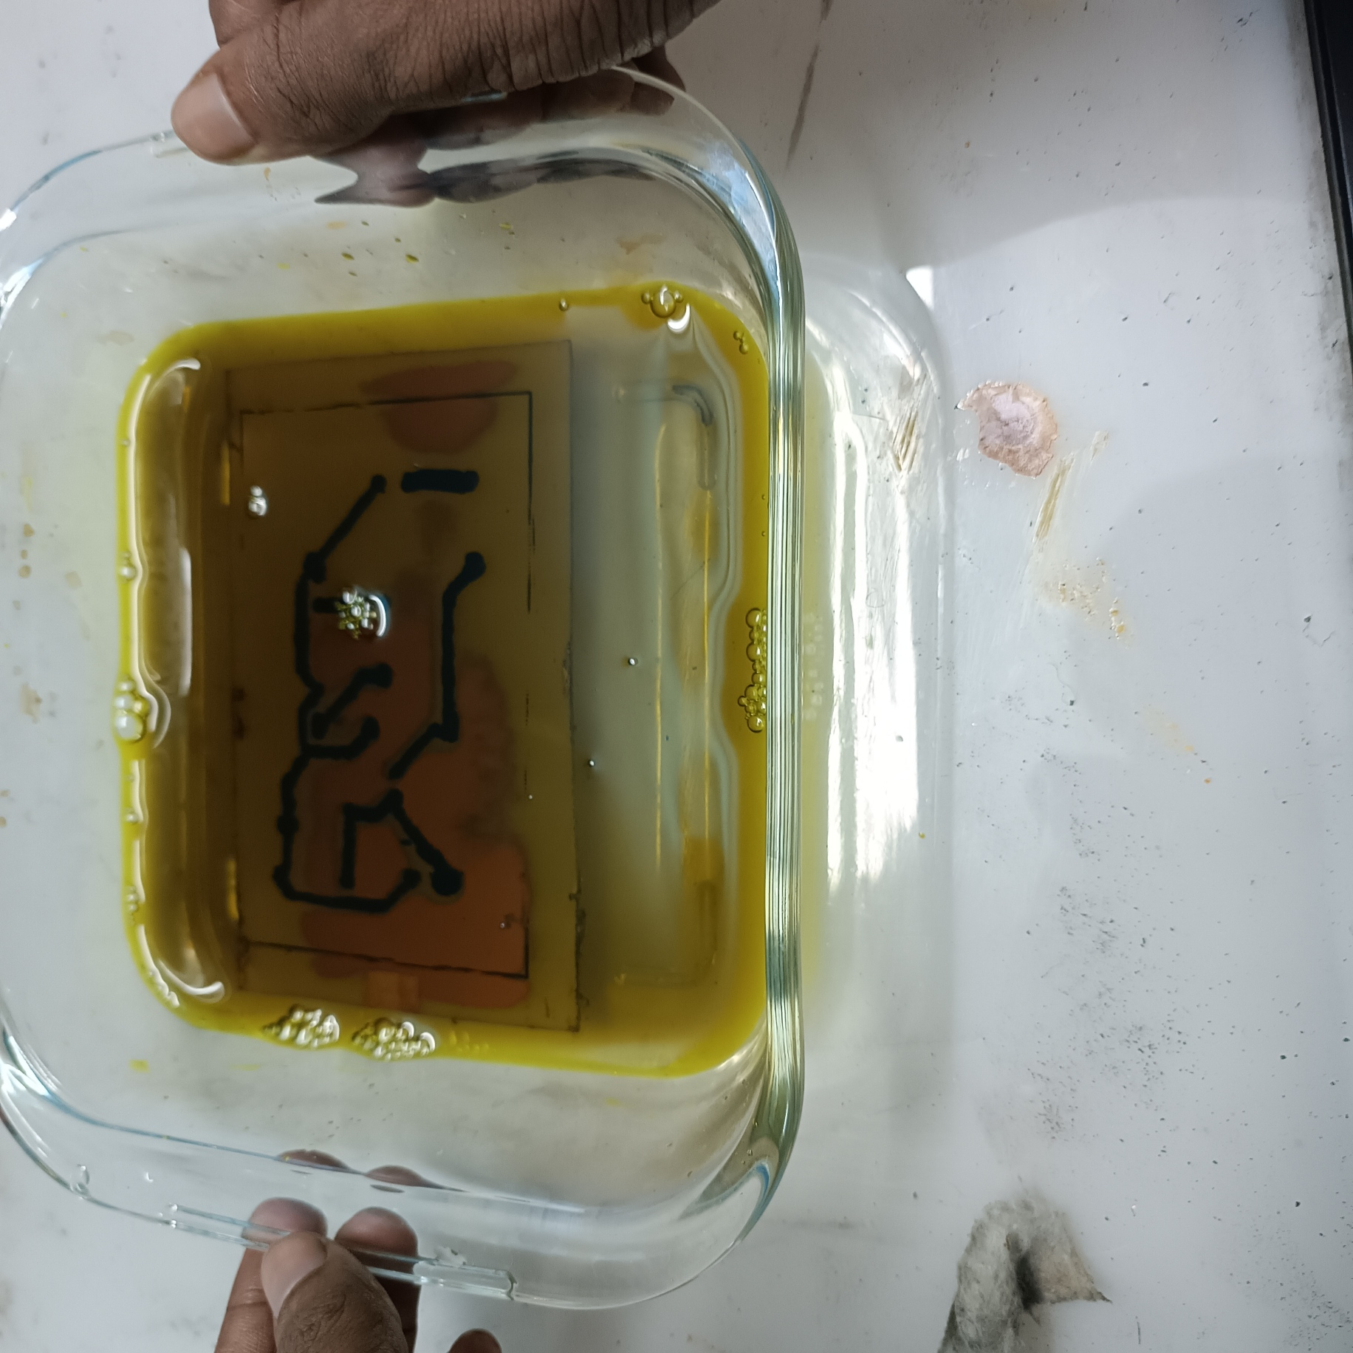
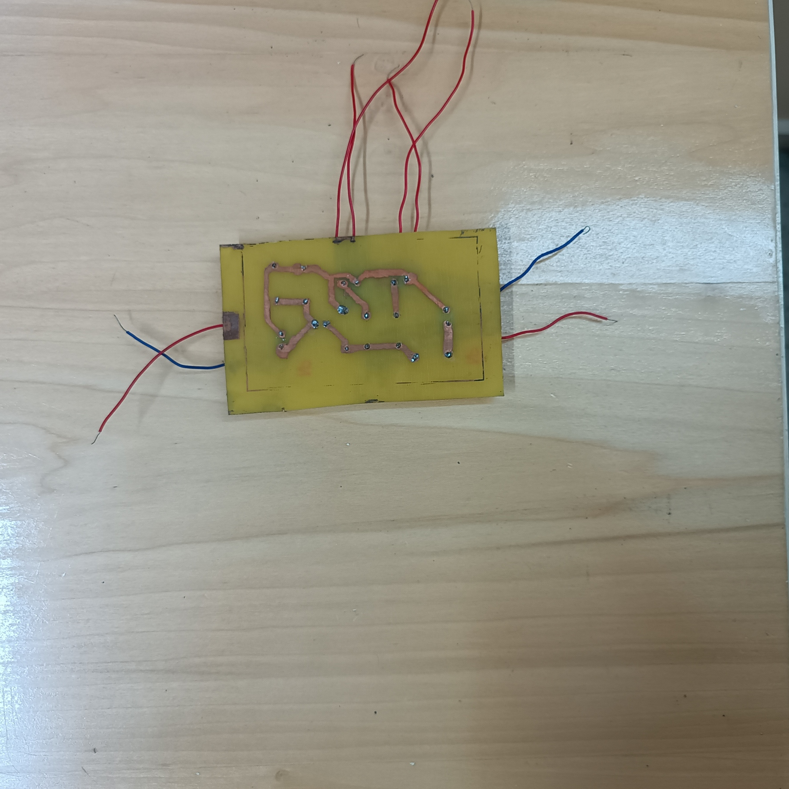
PRINTED CIRCUIT BOARD (PCB) DESIGN
PCB ETCHING PROCESS
Fig.15.5: Top View (Components On PCB)
PCB ASSEMBLING
Fig.15.1: PCB Design Layout Using EasyEDA
Fig.15.4: PCB Drilling
Fig.15.2: Mirrored Image Of Circuit Design Layout For Temporary Mask
PCB LAYOUT DESIGNING
PCB DRILLING
Fig.15.3: Etching By Ferric Chloride Solution
Fig.15.6: Bottom View (Connecting Tracks)

Slide 11
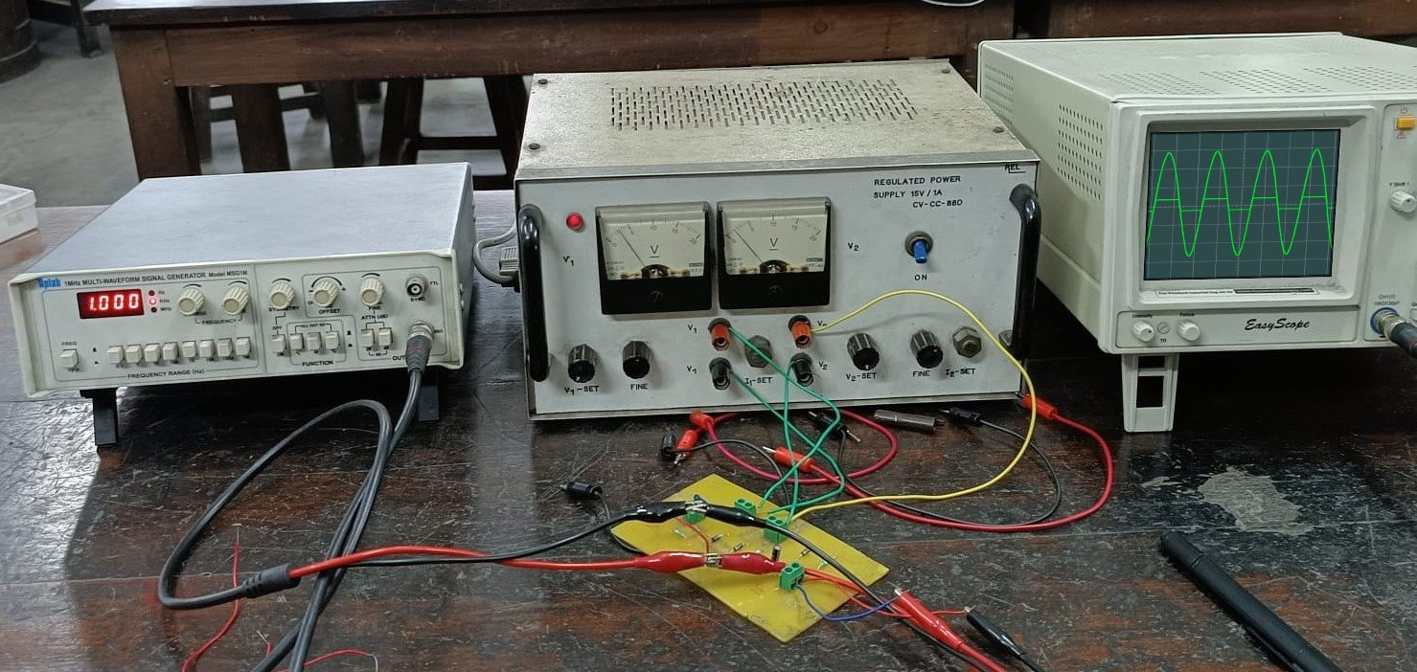
RESULT AND DISCUSSION:
Conclusion: The clipper-clamper circuit was successfully designed, implemented, and tested on a PCB. It effectively clipped the input sinusoidal waveform and shifted it upward using a positive clamper. The real-time output matched the expected results, confirming proper operation.
Fig.16.1: Working Of The PCB Design In Real Time
Applications
(1) Overvoltage Protection for Sensitive Devices
Maintaining the signal levels within desired dynamic range
By clipping the signal at ±2 V, we protect downstream circuits (like op-amps or microcontroller inputs) from higher voltage spikes
(2) Analog-to-Digital Converter (ADC): This circuit ensures:
The signal does not exceed upper/lower voltage limits (due to clipping)
The signal is shifted into the ADC’s input range (due to clamping)
Precautions :
Avoid 90° traces in PCB design to prevent signal reflections and broken tracks during etching.
Fix broken PCB tracks using nail polish or a marker before etching to ensure continuity.
Check diode orientation, maintain correct capacitor polarity, and use proper ±2 V bias. Ensure tight connections, use a regulated power supply, and set the function generator to 25 V peak, 1 kHz. Allow time for capacitors to charge before observation.

Slide 12

ACKNOWLEDGEMENT
We sincerely thank our supervisor, Prof. Kaushik Mandal, for his valuable guidance, and Prof. Santanu Mondal for his constant encouragement. We are grateful to the Institute of Radio Physics and Electronics, University of Calcutta, for providing the necessary facilities. We also acknowledge the support of Mr. Deb Kumar Majhi, Analog Devices lab assistant, for his kind assistance and helpful feedback.
BIBLIOGRAPHY
Microelectronic circuits book by Adel Sedra and Kenneth Smith.
Lab manuals and resources from the Institute of Radio Physics and Electronics Department, University of Calcutta.
Introduction of clippers circuits: https://www.geeksforgeeks.org/digital-logic/introduction-to-clippers/
Introduction of clampers circuits: https://www.tutorialspoint.com/electronic_circuits/electronic_clamper_circuits.htm
YouTube- ALL ABOUT ELECTRONICS:
https://www.youtube.com/watch?v=S76CnEJMl5E&list=PLwjK_iyK4LLBVM18VZ7JKW-q88FAtnr8_&index=48
https://www.youtube.com/watch?v=7O3Hbkkt624&list=PLwjK_iyK4LLBVM18VZ7JKW-q88FAtnr8_&index=50

